Slide 1
Chapter 13: Building the Price Foundation

Slide 2
Marketing Strategy Overview – Basic Structure
Analyze the environment and set the strategy
Company
(strengths & weaknesses)
Customers
Segment the market
Target your customers
Position your product
Competition
Product
Price
Promotion
Place
Leveraging real tools to implement strategic objectives

Slide 3
Preview
Price
Value
Elasticity of demand
Break-even

Slide 4
Louis XVI – potato champ
Knowing that potatoes could be a key to feeding a nation in recession, Louis XVI took one of the best royal plots of land, planted it with potatoes and put out the most elite guard during the day.
At night, after the guards left, peasants would come steal the potatoes from the land—exactly as Louis XVI wanted.

Slide 5
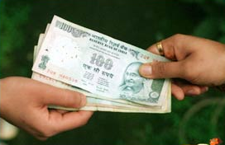
What is Price?
Price
The money or other considerations exchanged for ownership or use of a good or service
Barter – exchanging goods and services for other goods and services rather than for money

Slide 6
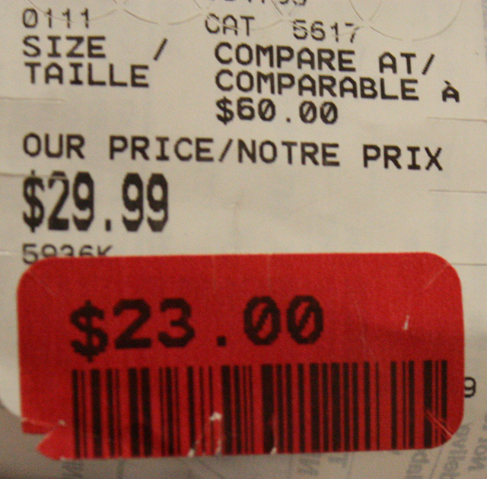
Price
Many factors increase or decrease price
Increases are caused by:
Extra fees
Extra Charges
Penalties
Decreases are caused by:
Discounts
Allowances
Rebates
Final Price = list Price – (incentives + allowances) + extra fees

Slide 7

Price Indicates Value
Value = Perceived Benefits
Price
This is the ratio of benefits to price
Panera
Price influences consumers’ perception of quality and value to customers
What is the VALUE of this t-shirt when I tell you the price is $3.00 vs. $300

Slide 8

Value
How does this concept relate to the “Have You Ever Tried to Sell a Diamond?” article?

Slide 9



When you’re not sure…
Would you infer that this hammer is the best one?
$17.95
$22.00
$9.75
oftentimes, price serves as a proxy for quality

Slide 10

Pricing in Marketing Mix
Profit Equation:
Profit = Total Revenue – Total Cost
Total Revenue = (Unit Price x Quantity Sold)
Unit Price: $200
TR:
$200 x 4 = $800
Cost: $50/ club
Profit:
$800 – (4 x $50) = $600

Slide 11
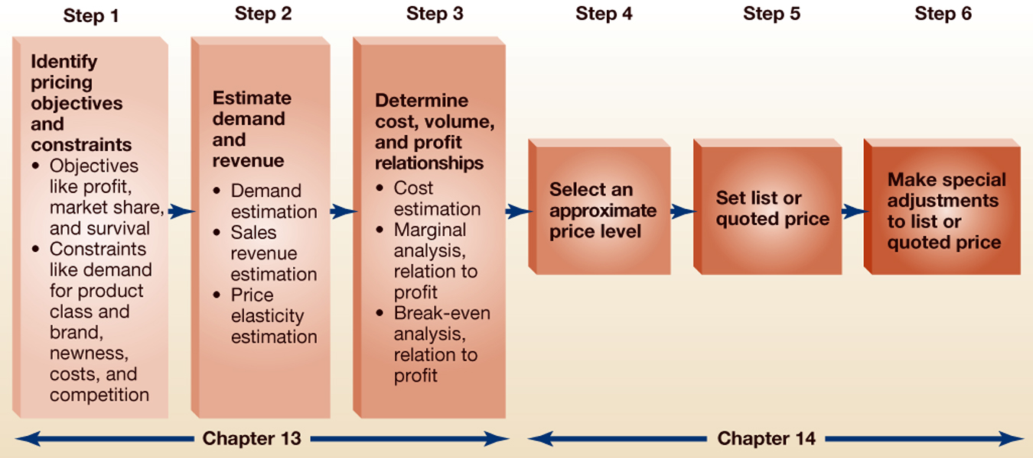
6 Steps of Setting Price

Slide 12
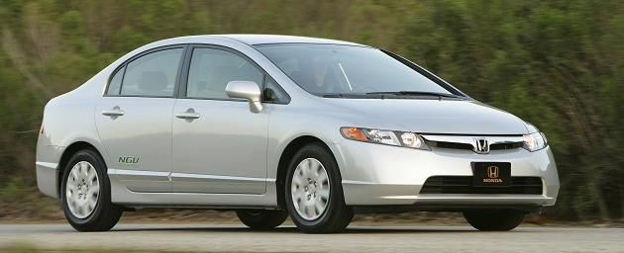
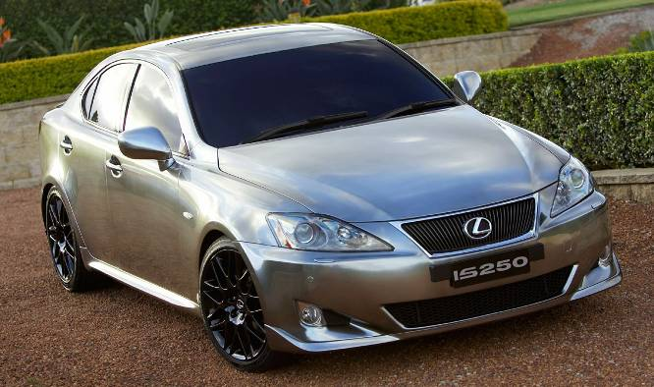
Step 1: Identify Pricing Objectives & Constraints
Specifying the role of price in orgs. marketing and strategic plans
Honda Civic
Lexus IS 250
How do each of these companies approach the price of their cars?

Slide 13
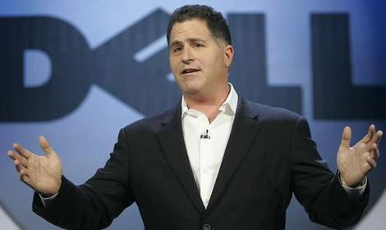
Profit
3 Objectives relate to a firm’s profit which is measured as (ROI) or (ROA)
Return on Investment/Assets
1. Managing for long-run profits
Give up immediate profit by developing high-end products to penetrate competitive markets → profits generated via market share
Michael Dell says that his company "is investing for its future" and that short-term losses might be a prerequisite to long-term gains. The buyout can thus been seen as Michael Dell's concession that additional short-term losses could be part of his long-term vision, and that investors focused on quarterly earnings would be an impossible hurdle.
Notes:
In a perfect world, managers would be equally incentivized to all make long term strategic decisions. However, because in public companies the stocks are more liquid, investors can make quick decisions and those decisions are largely based on profits reported to the market. Moreover, there is an information asymmetry such that investors have to rely on the signals that are provided to them (in the form of profits) and what managers tell them. Thus, if a company is making sacrifices which impact its bottom line, stockholders are likely to sell and the share price drop based on this information.
I.e. one analyst projected that Dell going private could shield them from the pressure to post continual growth on a quarterly basis, could refocus itself on thin clients and cloud computing, which could set itself up for a breathtaking turnaround.

Slide 14
Profit
3 Objectives relate to a firm’s profit which is measured as (ROI) or (ROA)
Return on Investment/Assets
2. Maximizing current profit
Setting a short term profit (quarter year or less)
3. Target Return
Firm sets specific profit goal

Slide 15
Price Objectives
A business set price to meet objectives like:
Generate a certain amount of sales
Market Share
maintain or increase firms sales as percentage of ttl. market
Unit Volume
Maintain or increase the number of products sold
Survival
Mere survival in a competitive market
Social Responsibility
Setting product price low enough to make product affordable to people that need it

Slide 16

Identifying Pricing Constraints
Demand for the Product Class, Product and Brand
The # of potential buyers
More demand, higher price can be charged
Newness of Product:
Stage in product lifecycle → newer product can charge higher prices
Single Product vs. Product Line
Must be consistent with other products in the market based on features
Cost of Producing and Marketing Product
Firm must cover cost of producing and marketing product
Cost of Changing Prices and Time Period they Apply
If selling to multiple consumers, time and effort to change product prices
Type of Competitive Markets
If market is highly competitive, harder to change prices
Competitors’ Prices
More difficult to change prices if competitors’ prices were “standard”

Slide 17
Market Competition
Pure Competition
Selling identical products
Monopolistic Competition
competing producers sell products that are differentiated from one another as good but not perfect substitutes (such as from branding, quality, or location).
Oligopoly
market or industry is dominated by a small number of sellers
Pure Monopoly
a specific person or enterprise is the only supplier of a particular product

Slide 18

How Did Starbucks Deal with Constraints of This Product?

Slide 19
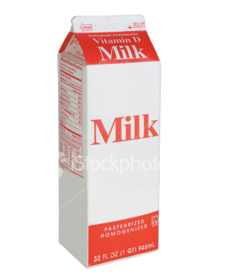
Imagine you want to increase the price of this
What are your constraints?

Slide 20
Step 2: Estimate Demand and Revenue
Translate consumer demand into expected revenue
Intuition: Lower price, Increase demand.
BUT, you have to offset less profit per product with volume
It’s not possible to offset losses in profits with volume

Slide 21
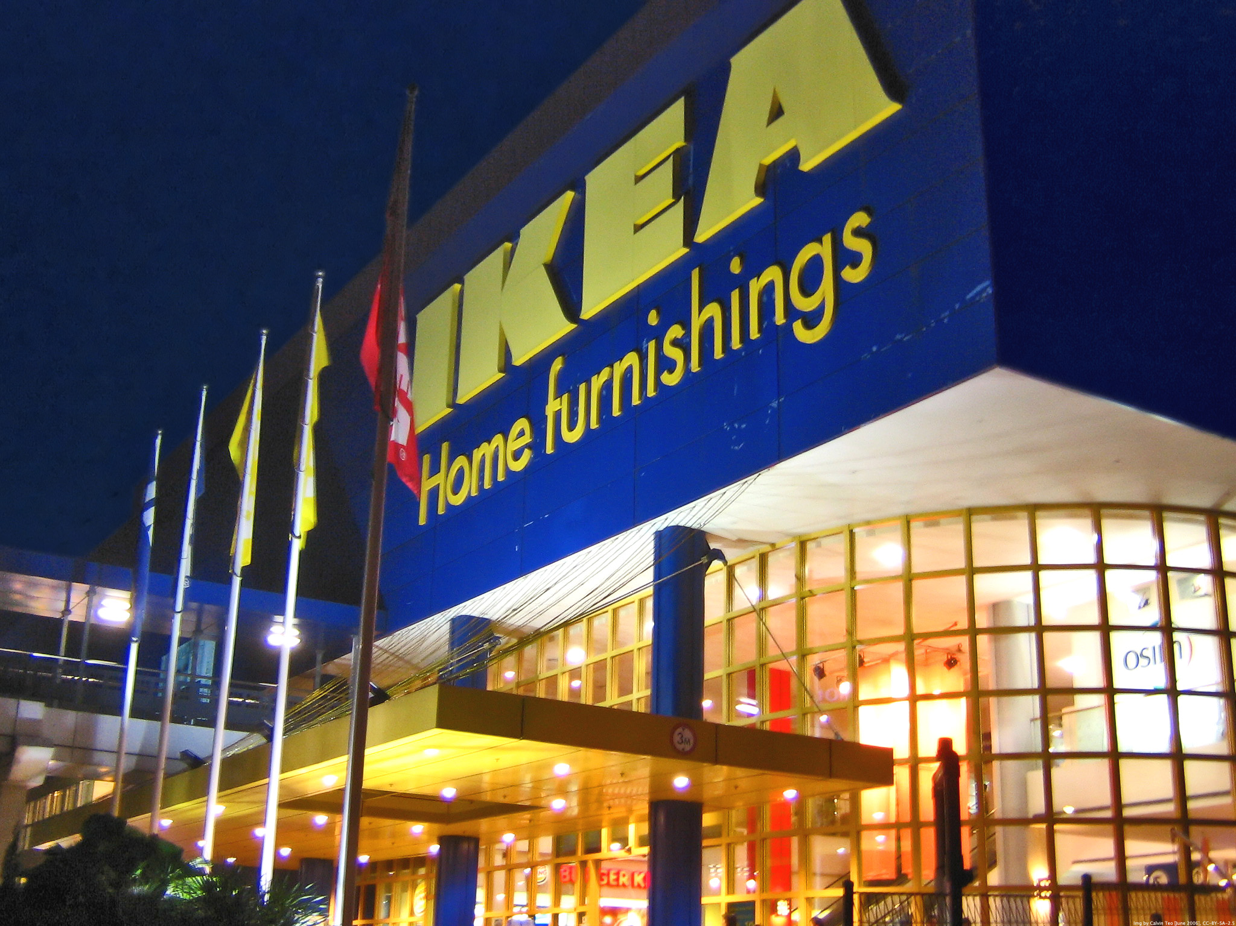
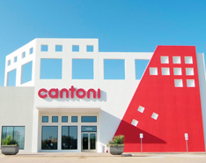

Slide 22
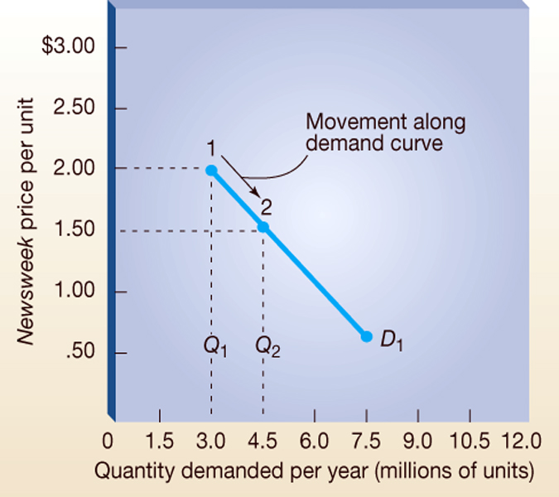
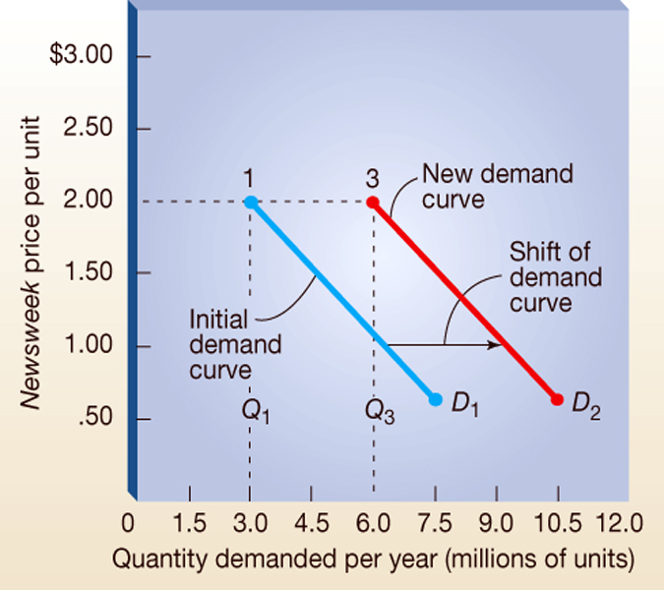
Demand Curve
Graph relating the quantity sold and price
Demand curve under initial conditions
Shift in the demand curve with more favorable conditions
Notes:
So, the first graph just shows that as price increases/ decreases, consumer demand decreases/increases
In order for the red line → more favorable conditions would need to occur (outside of price) → consumer tastes change, a competitor vanishes or increases in price, consumer income increases ect.

Slide 23
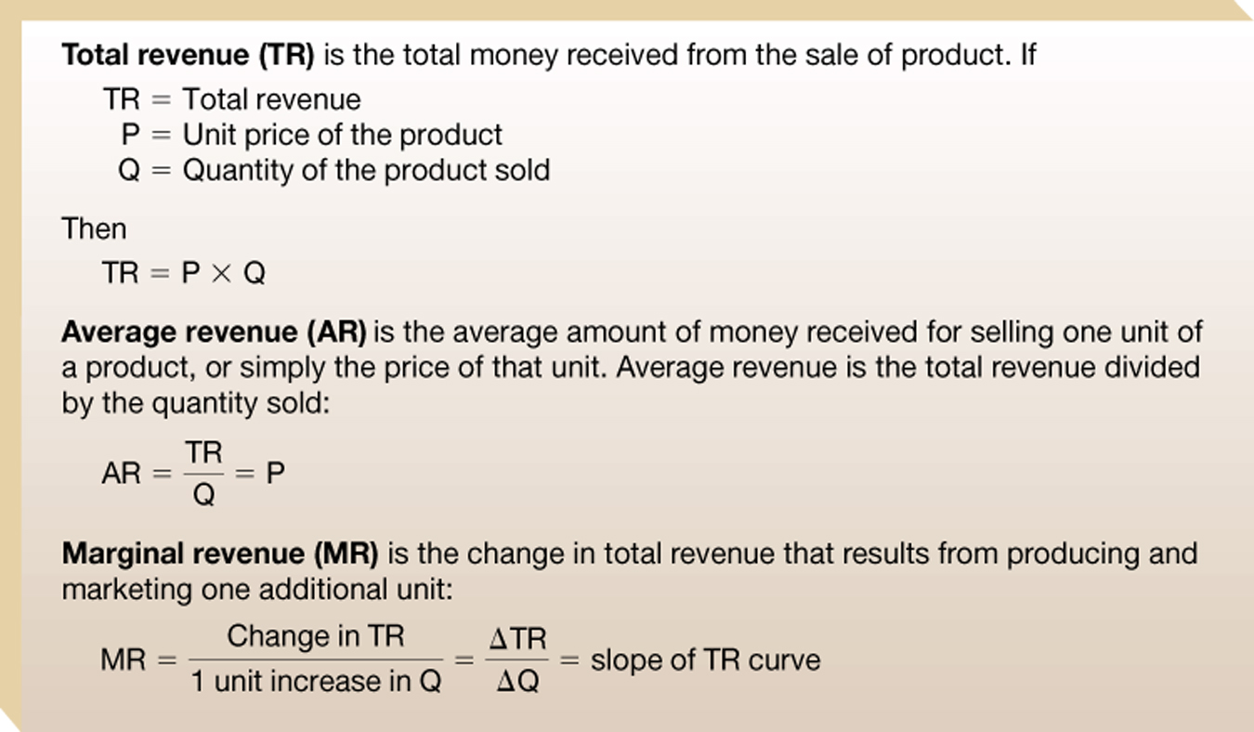
Fundamental revenue concepts
**In other words, MR is the additional revenue that will be generated or lost by increasing product sales by 1 unit.
Slide 13-32

Slide 24
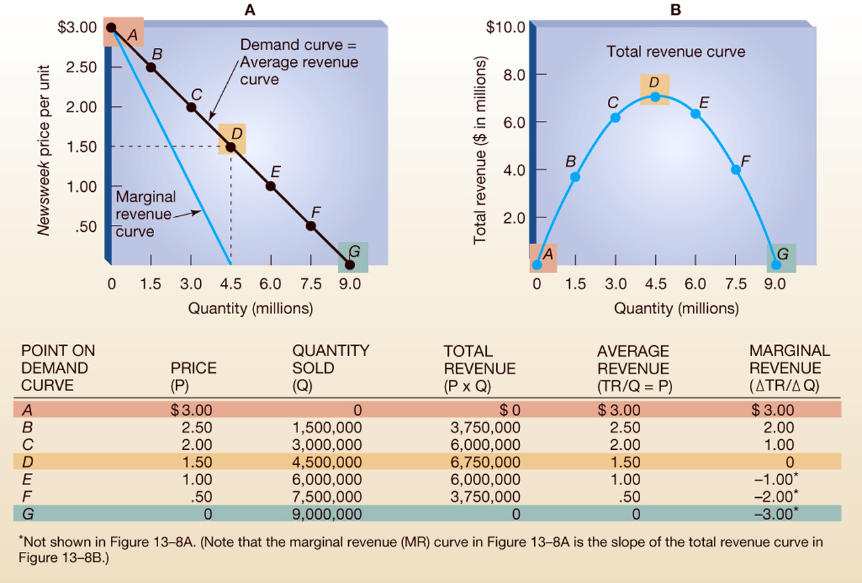
How a demand curve affects total, average, and marginal revenue
As price decreases and demand increases from A –D, total revenue increases; D – G total revenue decreases
At 4.5 sold, marginal revenue is 0. No more additional revenue can be generated by selling one more Newsweek!
Slide 13-33
Notes:
Up until point D, the decrease in profit per magazine is offset by the increase in demand but after D, there is a negative marginal revenue with each decrease in price point

Slide 25
Marginal Analysis and Profit Max
Marginal Analysis
Incremental costs against incremental revenues
Big Idea: as long as revenue received from the sale of an additional product (marginal revenue) is greater than the additional cost of producing and selling it (marginal cost), a firm will expand its output of product

Slide 26
Elasticity of Demand
How sensitive are consumers to changes in price?
Price Elasticity of Demand = % in Quant. Demanded
% in Price
Elastic Demand
When 1% decrease in price produces more than 1% increase in quantity – actually increases sales revenue
Inelastic Demand
When 1% decrease in price produces less than 1% increase in quantity – actually deceases sales revenue
Unitary Demand
When % change in price in price is identical to % change in quantity demanded – sales revenue remains same

Slide 27

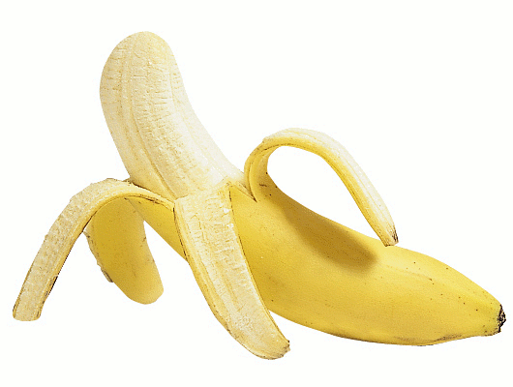

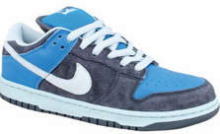
Price Elasticity of Demand
Determined by Factors:
Substitutability
More subs → more price elastic
Necessity (or not)
If it is → more price inelastic
Price compared to wealth
If high priced (vs. wealth) → more elastic
Consumers are also more inelastic after being exposed to advertising!
Notes:
Think of elasticity as how willing people are to pay an increase price → if they have a lot of other choices, they are less likely to pay higher prices BUT if there are not other options, their demand is not elastic or flexible – they HAVE to have that one…
How elastic are we for the products listed? How does BRAND affect this?

Slide 28
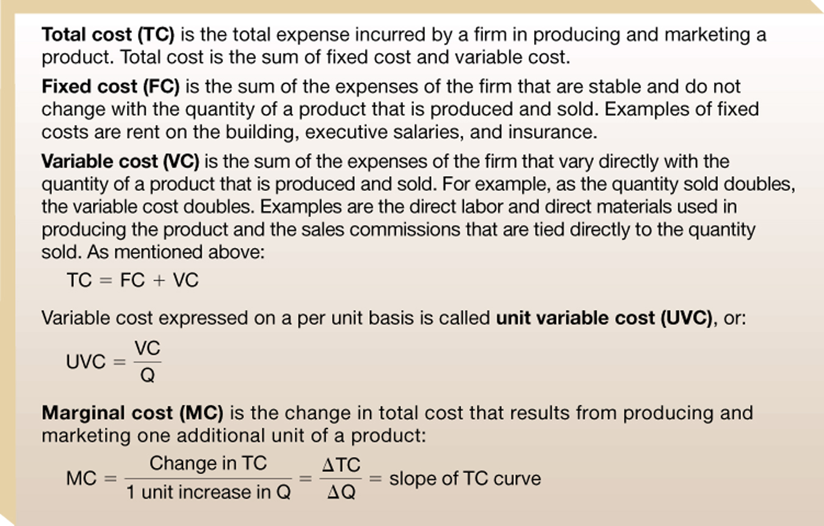
Step 3: Determine Cost, Volume & Profit Relationships
Costs or Expenses are the monies the firm pays out to its employees and suppliers

Slide 29
Break even analysis
Break even point is the point either in volume or dollar terms where total cost = total revenues, i.e. no profits/losses
Anything below the BEP would lead to losses and anything above the BEP would contribute to profits. Thus, the BEP is the minimum level of sales you must achieve in order to avoid a loss.
Break even market share indicates how much of the market you need to capture to avoid losses.

Slide 30
Break-Even Analysis
An technique that analyzes the relations between total revenue and total costs
used to determine profitability at different levels of output
Break-even point = Fixed Cost
Unit Price – Unit Variable Cost

Slide 31
Calculating Break-Even Point
Let’s try one:
Break-even point = Fixed Cost
Unit Price – Unit Variable Cost
Imagine:
You have a company that sells a product that costs $.30/product to produce. Also, you have fixed costs of $40,000 annually to cover. You charge $2.00/product. What is your break-even point?
Notes:
The message of marginal analysis is to operate up to the quantity and price level where marginal revenue equals marginal cost. Up to the output quantity at which MR=MC, each increase in total revenue resulting from selling one additional unit exceeds the increase in the total cost of producing and marketing that unit. Beyond the point at which MR=MC, however, the increase in total revenue from selling one more unit is less than the cost or producing and marketing that unit. At the quantity at which MR=MC, the total revenue curve lies farthest, above the total cost curve, they are parallel, and profit is at a maximum.

Slide 32
Activity
Please do the following calculations using the information provided:
Total Revenue
Average Revenue
Total Cost
Unit Variable Cost
Profit
Break-even point (assuming you DON’T know in advance that you will be selling some products on sale)

Slide 33
Activity
You are a marketing manager with the following financial information:
You recently started a business selling widgets. You made and sold 230 widgets last year at $4.50 each. However, you gave a 20% discount on 30 of the widgets. You know that you have fixed costs of $50,000 and $345 in variable costs each year .

Slide 34
Activity
Please do the following calculations using the information provided:
Total Revenue = Price*Quantity = (200 * $4.50) + (30 *3.60) = $1008
Average Revenue = Tot. Rev/ Quantity =1008 /230 = $4.38
Total Cost = Fixed Costs + Variable Costs = $50,000+ $345 = $50,345
Unit Variable Cost = VC/U = $345/230 = $1.50
Profit = Total Rev – Total Costs = $1,008 - $50,345 = -$49,337
Break-even point = Fixed Costs/ Unit Price – UVC
50,000/(4.50 - 1.50) = 50,000/3 = 16,667
** Use $4.50 as Unit Price because this is a projection tool – you don’t know how many you will sell on sale.

Slide 35
Review
What are the six steps in setting price?
How is the break-even point calculated?
What is elasticity?

